Slide 1
How 6 stroke engine works (Patient in17 April 1990, In India May 2012)
SKYLINE INSTITUTE OF ENGG & TECHNOLOGY
By:- Mohd. Monish
ME(B2)
3rd year
Roll No:- 1315340121

Slide 2
Objective
Sources Referred
History
Classifications of 6 stroke engine
Parts of 6 stoke engine
Working of 6 stroke engine
Graph of Otto cycle for (6s) or (4s)
Uses of 6 stroke engine

Slide 3
Process occur in 6 stroke engine
Conclusion
Thanks

Slide 4
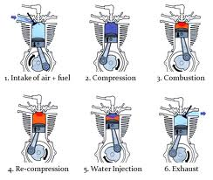
Sources Referred
Web
Books

Slide 5
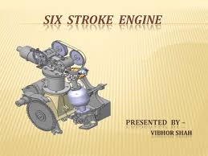
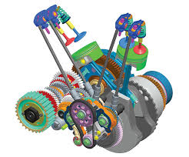
History
It is a type of IC engine based on 4 stroke engine.
Two type six stroke engine developed in 1890s.
In the first approach, called single piston design.
The second approach, called the opposed piston engine .

Slide 6
Classification based on single piston designs
Griffin six stroke Engine (1883 by Samuel Griffin).
Dyer six Stroke engine (1915 by Leonard Dyer).
Bajulaz six stroke engine (1989 by Roger Bajulaz).
Velozeta six stroke engine (2005 by some mechanical engineering students).
NIYKADO six stroke engine (May 2012 by Chanayil Cleetus Anil, Kochi).
Crower six stroke engine (2006)

Slide 7
Classification based on opposed piston design
Beare head 6 stroke engine( Malcom beare belongs 2 Australia, 9% benefit of power).
Piston Charge Engine(Helmut Kottman from Germany)
M(4+2) engine( common with beare head engine)

Slide 8
Parts of 6 stroke engine
Water cooling passage
Cam shaft
Cam
Fuel injector
Cylinder head
Rocker Arm
Exhaust valve
Crankpin
Gudgeon pin
Crank case

Slide 9
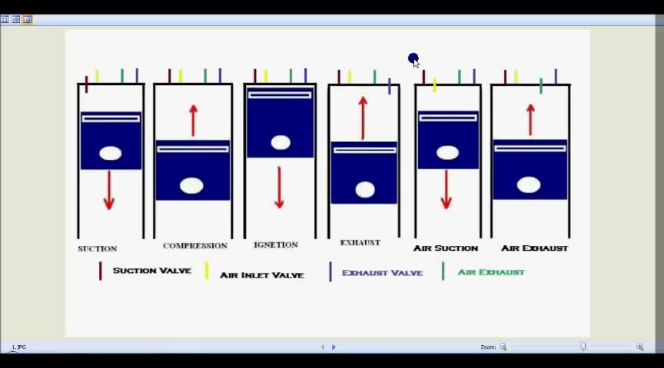
Working of 6 stroke engine

Slide 10
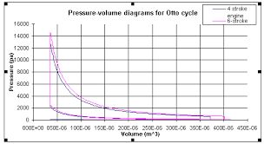

Slide 11
How to supply fuel in 6 stroke engine?
Carburettor.
Gasoline direct injection.
Common rail.

Slide 12
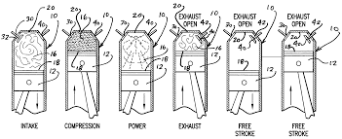
Process Occurs in 6 stroke engine

Slide 13
Conclusion
3 Revolution of crank takes place.
This type of engine is work as 2 stroke or 4 stroke engine, it generates high power in comparison to 4 stroke or 2 stroke .

Slide 14
THANKS

